Slide 1
High Dynamic Range Imaging
(Advanced Calibration Too)
O. Smirnov (Rhodes University & SKA SA)

Slide 2
What Is Dynamic Range
A black art
  ...all current HDR results are one-off reductions
A marketing exercise
  ...we do it for bragging rights
The ratio between the brightest source in your field, and the brightest artefact left after calibration
  ...or the noise, if you get to it

Slide 3

World Record Dynamic Range
(still, after 2 years...)
3C147 @21cm
12h WSRT synthesis
160MHz BW
22 Jy peak
13.5 μJy noise
1,600,000:1
Regular selfcal does not
reach noise, leaves
off-axis artefacts (“luxury
problems”) due to
direction-dependent
effects (left inset)
Addressed via differential
gains (right inset)
3C147 22Jy
30 mJy

Slide 4
The Competition...
EVLA: 2x number of dishes, massive bandwidth
  900,000:1 (same field @21cm)
  Working on “4M” project
LOFAR: 3x number of stations, massive bandwidth, massive sensitivity – pushing a million
  Which is extremely impressive, considering the low-frequency, wide-field regime
DR is not important 

Slide 5
An Inconvenient Question
All very interesting and
challenging for it own sake,
but where's the science?
That is, what results has
this enabled that we
couldn't have achieved
otherwise?

Slide 6
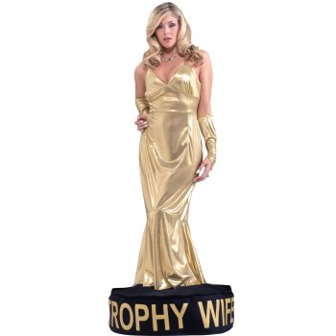
An Inconvenient Question
The answer (as of a few months ago) was, not very much
But if so, then high DR...
  ...consumes an excessive amount
  of time and resources
  ...and is only good for showing off?
Is it the trophy wife of
radio interferometry?

Slide 7

Not Always...
Recall talk by
Ian Heywood
The DR here is not too high, but it's the HDR-driven techniques have enabled the science in this particular case
And now think of LADUMA...
This is your science
(good luck!)
This is your
phase calibrator

Slide 8
Setting The Scene: Quotes
“Sensitivity is king, and dynamic range is the dominant queen.” –Justin Jonas
“The Devil in E-Jones†” –Brad Frank
“Everybody in the world has an E-Jones problem.”
–Jan Noordam
“My sidelobes are better than your sidelobes!”
–Tony Willis sums up the SKA Dish CoDR
“Know Thy Beams.” –me
“Where's the nearest pub?” –Steve Rawlings
†The E-Jones term of the RIME describes the primary beam pattern.

Slide 9
Differential Gains, In a Nutshell

Slide 10
A.k.a. “The Flyswatter”
The Good:
  dE's can completely eliminate contaminating sources, making for great maps!
  See also talks by Ian Heywood, Panos Labropoulos
The Bad:
  Computationally feasible for a “handful” of sources at most
  Proliferation of degrees of freedom
The Ugly:
  Mashes together all information on both the source and all instrumental effects towards it

Slide 11

The Ugly, continued...
...and makes no use of spatial continuity.
So we'd really like to learn to fit some “global” DDE models instead
Example: 3C147 field, dE-phase solutions:
WTF is
it doing
that?

Slide 12
The Ugly, continued...
...and makes no use of spatial continuity.
So we'd really like to learn to fit some “global” DDE models instead
Example: 3C147 field, dE-phase solutions:
WTF is
it doing
that?

Slide 13
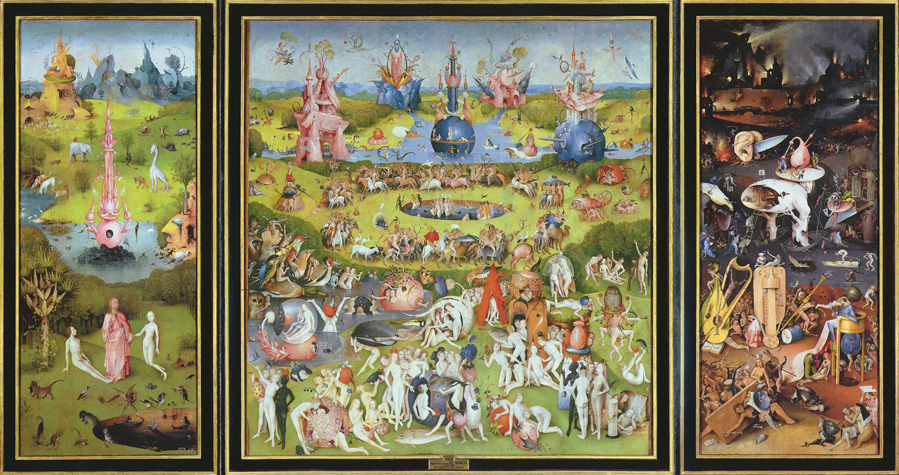
A773: The WSRT Field From Hell
...or dynamic range horror stories

Slide 14
A773: Introduction
Part of Roberto Pizzo et al.'s WSRT cluster observing program
Looking for extended halo & relic emission
Multi-wavelength, but 300 MHz the nastiest
  Standard 6x12h, filled uv-plane
  8 bands 315-376 MHz, only 7 usable
Initial strategy:
  selfcal and LSM construction in NEWSTAR
  DDE calibration in MeqTrees

Slide 15
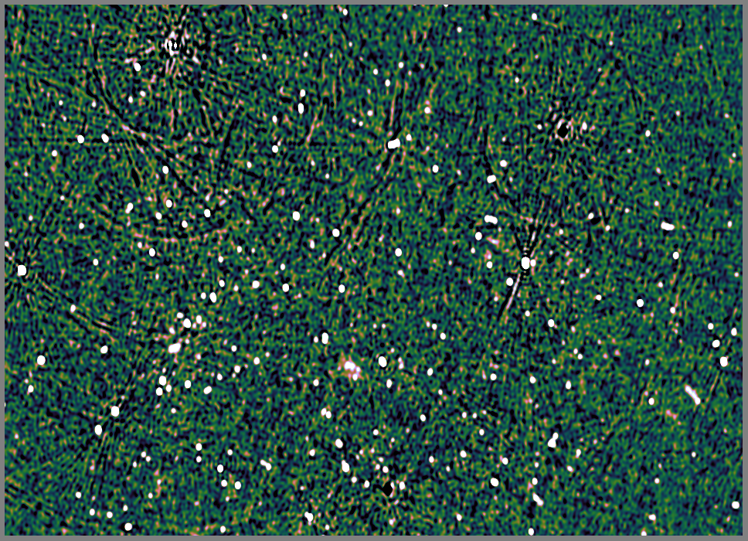
A773: NEWSTAR Selfcal + Peeling
1.1 Jy
750 mJy
1.1
470 mJy
σ=.09mJy thermal,
.3-.4 mJy confusion
620 mJy

Slide 16
A Few Small Problems
RFI
Odd telescope problems
All the dominant sources are off-axis
Affected by the ionosphere
...and also resolved

Slide 17
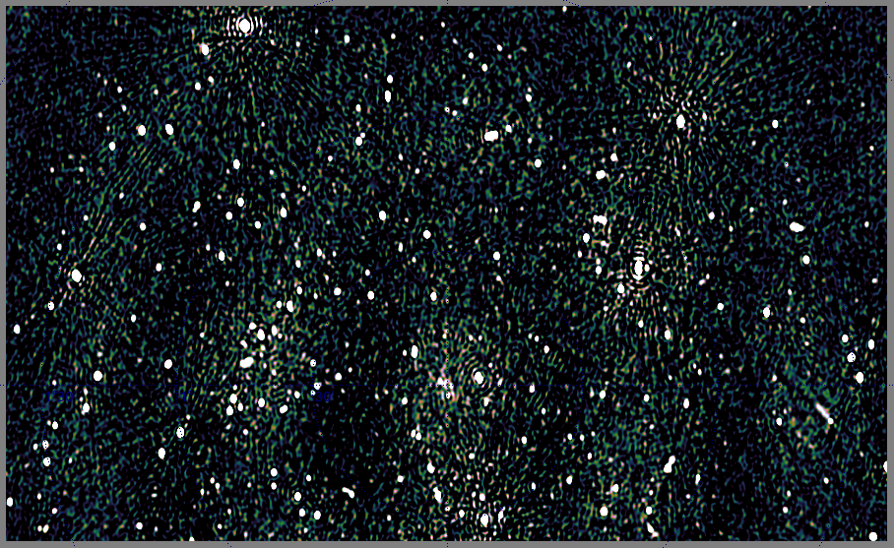
A Few Small Problems II
(a) resolved sources (b) RFI (c) ionospheric spokes

Slide 18
Why Is It So Difficult?
DR is a marketing ploy...
3C147 selfcal reaches
1.6 million to 1 on-axis
And ~1000:1 off-axis
(30-50 mJy sources leave
obvious residuals)
Differential gains produce
a noise-limited map
But this only proves we
can reach ~4000:1
...and that's good enough
to reach the noise because
everything off-axis is <50 mJy
σ =13.5 μJy
3C147 22Jy
30 mJy

Slide 19
Deconvolution Problems
Bright off-axis sources do not deconvolve well
Reasons:
  residual DDEs
  interaction with other sources in the map

Slide 20
The Postage Stamp Approach
Solve for G and all dEs
Per each source s0, make single-source corrected visibilities (SSCV):
...corrected by our best guess for the total gain towards s0
Residual visibilities for s0
Our current best prediction for the whole sky, sans s0

Slide 21
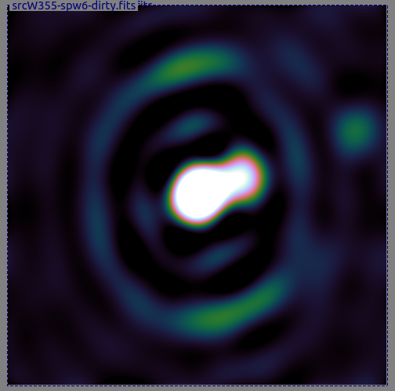
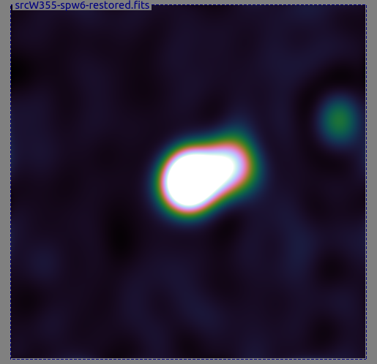
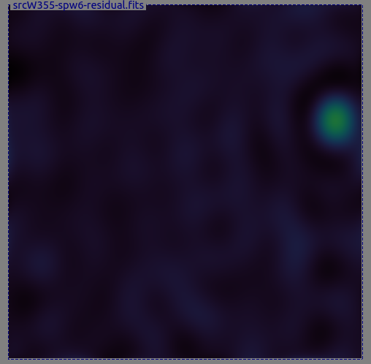
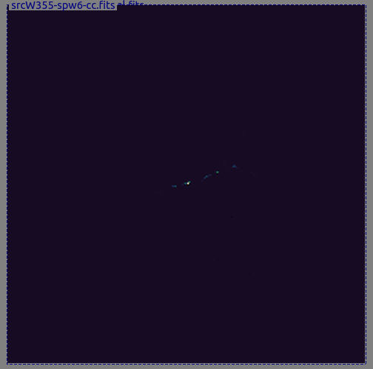
The Postage Stamp Approach II
3. Image the SSCV in a small box (“postage stamp”) centered on the source
  using all six nights
4. Deconvolve
  Using CLEAN
  Or shapelets?
  Or CS?
5. Build a hybrid LSM composed of source components and postage stamp models (CCs)

Slide 22
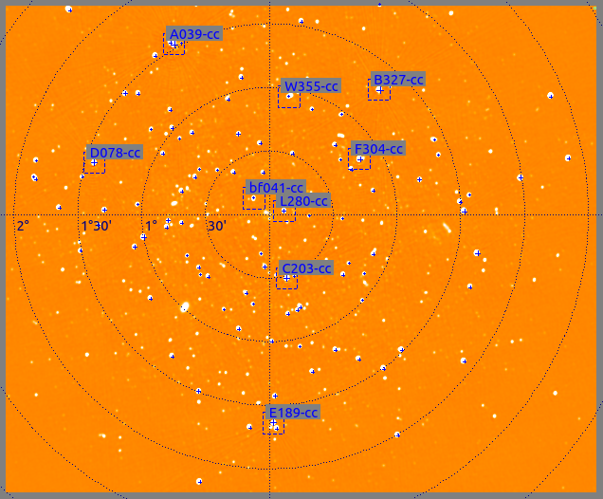
Hybrid LSMs & Tigger
The Tigger tool (FITS viewer and sky model manager) supports hybrid LSMs:
Point sources
Gaussian components
FITS images (multiple: thus different positions and resolutions)
Coming up:
Shapelets and other basis functions

Slide 23
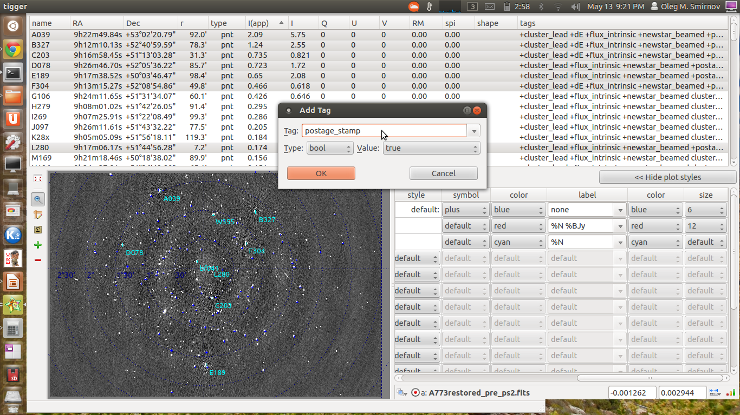
Postage Stamps In Practice
select
tag
select

Slide 24
Postage Stamps In Practice II
Designate sources for the “postage stamp” treatment using the Tigger GUI
  Useful to plot the LSM over a residual image while you do this
Assign them a “postage_stamp” tag
  similarly, the “dE” tag designates sources for a differential gain treatment
Run a script which will calibrate, generate SSCVs for designated sources, make postage stamp images, and insert them into the LSM

Slide 25
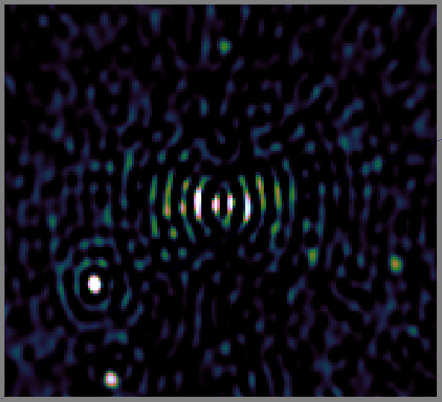
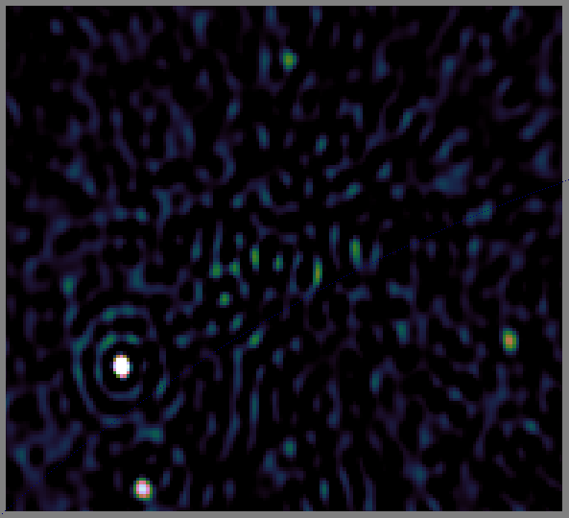
Postage Stamps: Before & After
Residual image for 1.1 Jy source in NE of field
Left: point source model; Right: postage stamp model
NB: the stamp can be at a higher resolution than we normally image at.

Slide 26
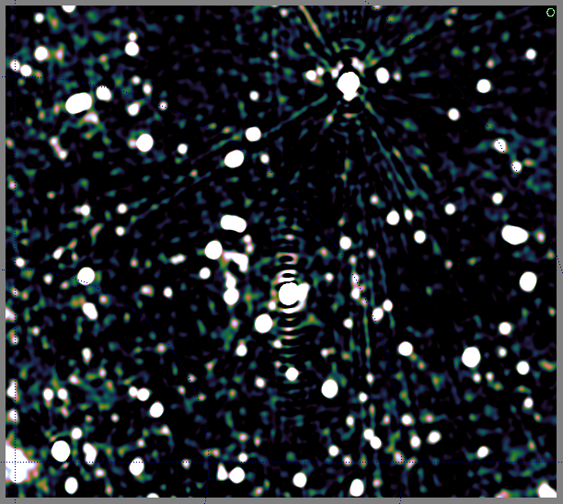
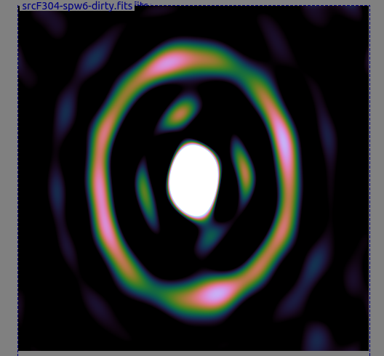
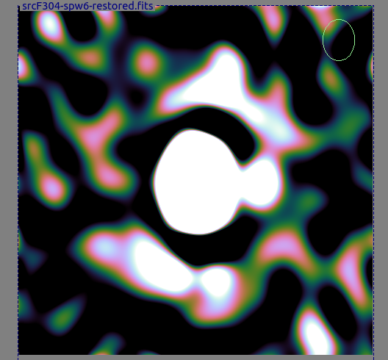
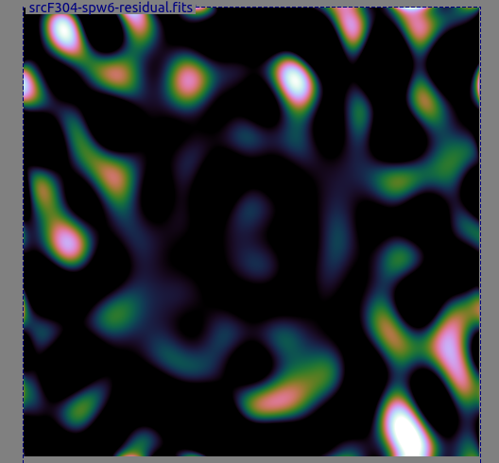
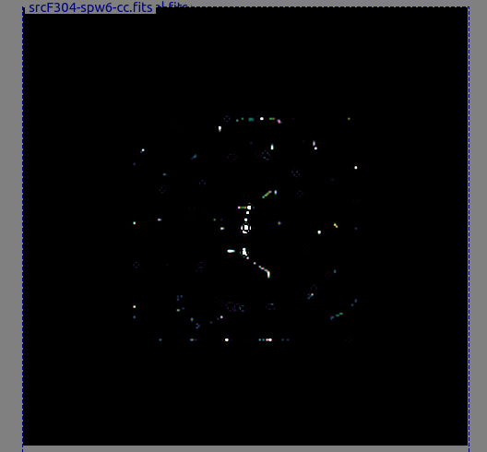
Not Always So Successful...
470 mJy source to NW of target
Needs something better than CLEAN

Slide 27

The Dangers Of
Direction-Dependent Solutions
Single-band residuals, no dEs (G only)

Slide 28

The Dangers Of
Direction-Dependent Solutions
Single-band residuals, with a few dEs – very nice map, right?

Slide 29
The Dangers Of
Direction-Dependent Solutions
Suppression of non-model sources
Our target

Slide 30

The Dangers Of
Direction-Dependent Solutions
Suppression is less with only one dE
Our target

Slide 31
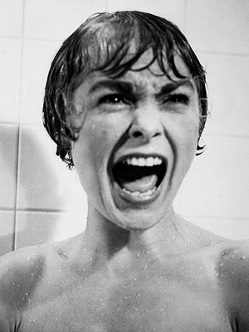
Source Suppression Via DD Solutions
Adding dE's will always suppress
some flux from non-LSM sources
(i.e. your science target!)
  See figure for correct response ➔
A clean, noise-limited map is
not necessarily good news!
Related to noise suppression,
familiar from selfcal
Basic mechanism: extra degrees
of freedom in the calibration model (the dE's) also absorb unmodeled flux

Slide 32
Mitingating Source Suppression
Source suppression can be mitigated by:
  Fewer direction-dependent
  solutions
  Longer solution intervals
  Split amplitude/phase solutions (longer intervals for amplitude)
  Having more baselines (good news for LOFAR, bad news for WSRT)
More investigation needed!
  Need quantitative estimates of the effect
  Can get a handle on it with some careful simulations

Slide 33
Degrees Of Freedom
Ultimately, source suppression is due to excessive degrees of freedom (DoF) in the calibration model
  Can reduce these by solving for dE's on longer intervals, but this trades off artefact level
Need better calibration models (i.e. capturing the instrumental effect with fewer parameters)

Slide 34
Alternatives:
Fitting a “Global” DDE Model
Pointing selfcal (S. Bhatnagar)
  Uses EVLA PB model, with a solvable pointing offset Δl,Δm
  First-order approximation to ∂χ²/∂(Δl), ∂χ²/∂(Δm)
  using FFTs and convolutional functions
  Uses entire sky model (image) as input
  Results (so far): seems to improve pointing solutions, but little reduction in imaging artefacts
  Possibly due to inadequate PB model?
AW-projection can apply “global” correction during imaging

Slide 35
The QMC* Project
Pick a field containing a cluster of reasonably bright off-axis sources
Observe with WSRT @21cm
Introduce deliberate (and secret!) pointing errors during observation
Attempt to recover these during the reduction
*) Named in honour of the long-defunct WSRT Quality Monitoring Committee. Yes, the Dutch do love their committees. Fortunately, so do the Russians.

Slide 36
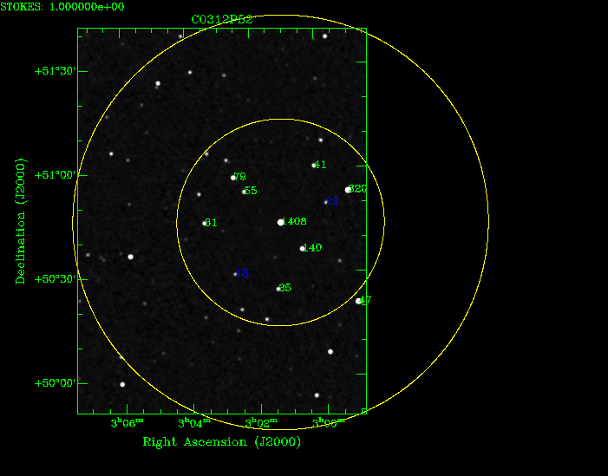
The Original QMC Field

Slide 37
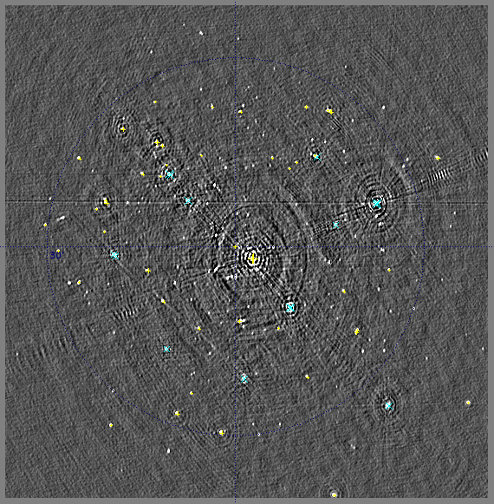
QMC Proves Tricky...

Slide 38
QMC Issues
A number of slightly resolved sources
  Including central 1.4 Jy one
Difficult to distinguish source structure from gain effects
  an extended source will have an HA-dependent visibility amplitude (on long baselines)
  how to distinguish this from real gain errors on antennas C and D?
Need to bootstrap a sky model!

Slide 39
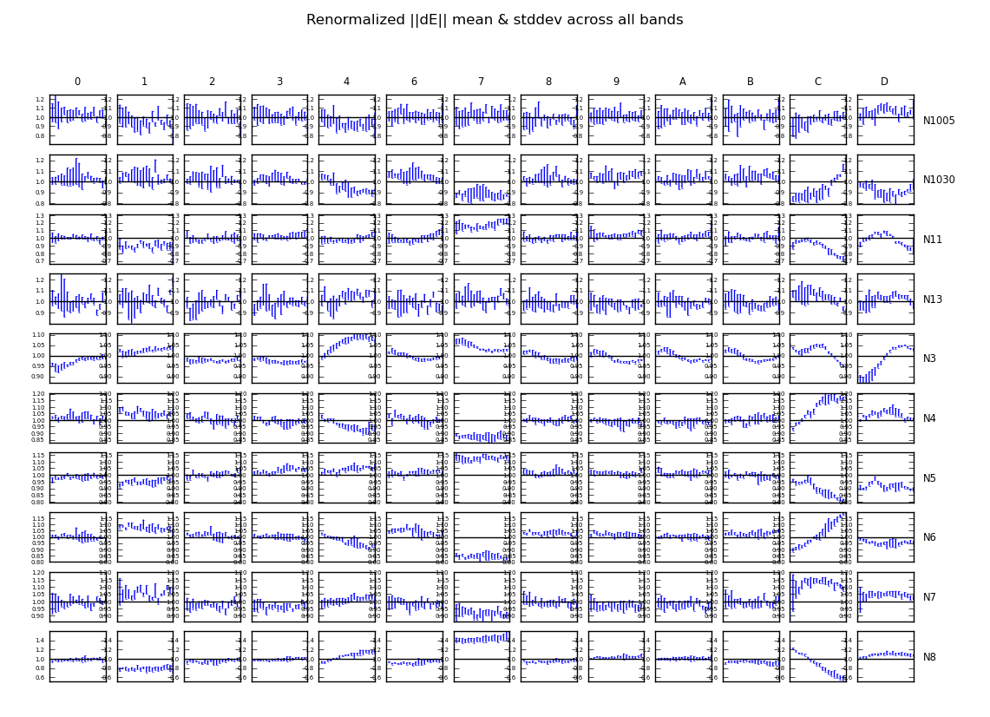
The Evidence

Slide 40

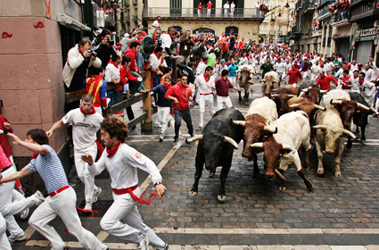
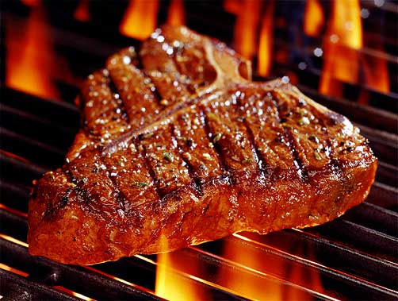
The QMC2 Field (01515+6736)
(a radio astronomer's worst nightmare)
>10 moderately bright off-center sources
The type of field that usually has radio astronomers running away screaming...
But perfect for our purposes!

Slide 41

Gifts Of QMC2
Initial observation (2010Jul3) was an “error-free” 12h synthesis, in order to build up a sky model
“I have never seen such
a terrible WSRT map!”
– Ger de Bruyn
Differential gains sorted
out the issue as usual

Slide 42


QMC2 2010Jul3 dE amplitudes
||dE|| solutions show large offsets on RT8, consistent with a significant mispointing to the North
Problem was reported to the Observatory, and they discovered a faulty encoder on RT8's declination axis

Slide 43

QMC2 2010Jul21:
Now mispointed
||dE|| solutions suggest a static mispointing of RT2, RT6, RT8
...and a time-variable mispointing of RTB
(“Hans's surprise”)
Hans confirmed that this was consistent with the mispointings he had put in.

Slide 44

“Rogues' Gallery” Plot
Plots of mean ||dE|| per antenna, at proper positions within the field.
Colour/size indicates
||dE||>1, <1.
(Note 3C source at NW!)

Slide 45
Solving For Pointing Errors
||dE|| plots are a reliable indicator of mispointing
  But only a very rough one...
Can we recover the actual pointing offsets?
A MeqTrees variation on pointing selfcal: DFT pointing solutions (see also “pointing selfcal” by S. Bhatnagar)
MeqTrees can “solve for anything”: we need to construct a suitable model where the pointing offsets are parameters, then designate them as solvable and say “go”.

Slide 46
DFT Pointing Solutions

Slide 47

P.E. Solutions (QMC2 2011Jul21)
Recovered solutions consistent with deliberate mispointings, but underestimate them:

Slide 48

Not so impressive...
Residual image,
post-selfcal

Slide 49

A Marginal Improvement
Residual image,
post-selfcal,
with pointing error solutions
(Note how this relative lack of improvement is consistent with Sanjay's pointing selfcal results.)

Slide 50

Nowhere Near The Flyswatter...
Residual image,
post-selfcal,
with differential
gains.

Slide 51
Parameterizing The Beam
The advantage of the DFT approach is that we can introduce other parameters into the primary beam model.
Just as a random example, we can introduce a per-antenna beam scale sp:
And then treat sp as a solvable.

Slide 52
P.E. Solution Only
Residual image,
post-selfcal,
with pointing error solutions

Slide 53

P.E. + Beam Extent
Residual image,
post-selfcal,
with pointing error and beam extent solutions
...not as good as differential gains, but an improvement!

Slide 54


Now Back To The Pretty Plots
Beam extent and pointing offset solutions are strongly coupled
Beam extent solutions are non-physical (±10%!)
More of the poitning
Obviously the extra degree of freedom is compensating for something else, but what exactly?

Slide 55
Compare To The PE-Only Case
P.E. solutions without a beam extent show more variance
...and underestimate the true mispointing to a larger degree
Tentative conclusion: P.E. solutions are limited by the accuracy of the beam model
...as are the final maps
There may also be a directional coupling determined by the configuration of sources in the field.

Slide 56
QMC2 “8-Way” Observations
To check for directional coupling, we asked for another observation of QMC2 with 8 antennas mispointed to 8 points of the compass (by 60 mdeg each)
This was done in March 2011, but due to some problems only 90 minutes of data were taken
Thus no imaging was possible
...but we could still do P.E. solutions
  (we'd been solving at 30-minute intervals before)

Slide 57


8-Way Pointing Solutions
Expected vs. fitted pointing offsets
With a solvable beam extent
Without a solvable beam extent

Slide 58
Know Thy Beams
(and the incestousness of selfcal)
Why not throw more parameters at the beam model?
We do NOT have absolute, intrinsic source fluxes. Selfcal gives us fluxes attenuated by some average primary beam.
Our solution is then only sensitive to differences between antennas (and timeslots).
Given a perfectly-pointed observation and identical PBs, our method is completely insensitive to beamshape.
Pointing errors give us a handle on the gradient of the beamshape.
  (this also explains why the beam extent solutions above are non-physical!)

Slide 59
The Next Step: A QMC2 Mosaic
Latest observation (2011Jul17): a 10-pointing mosaic, ~1 hour per pointing.
1 pointing to field centre,
9 pointings to off-axis
sources around the
half-power point.
8-way mispointed.
Will use this to
simultaneously constrain
source fluxes and PB
models.

Slide 60

Yet Another Twist: Solving For P.E.
On Shorter Time Scales
Solutions every 30 sec, 2.5 min and 5 min.
Longer time scales: decreased variance (higher SNR)
Diminishing returns above 5 min.
Show a striking feature unnoticed on the previous
(30 min.) plots...

Slide 61

And Now, Applying Sophisticated
Model Fitting Techniques...
Westerbork Wobble!
WW

Slide 62

The Wobble
A periodic (~20 min) variation in the pointing by 10-20 mdeg.
Shows up in other observations, on other antennas (to varying extent)
We can identify dominant “wobbly modes” by taking a Fourier transform of the P.E. solutions, and examining the amplitudes:

Slide 63
Wobbling Across 5 Epochs (RA)

Slide 64
Wobbling Across 5 Epochs (Dec)

Slide 65
Wobbly Features
RA & Dec coupled, Dec wobbles more
Only some antennas wobble
  But they differ epoch-to-epoch
Wobble amplitude varies epoch-to-epoch
  Can reach 20 mdeg (10 is nominal accuracy!)
  Some epochs much worse than others, why? (waiting for wind data)
Wobble period is 5 to 60 minutes
  Quite stable (up to 4 hours)

Slide 66
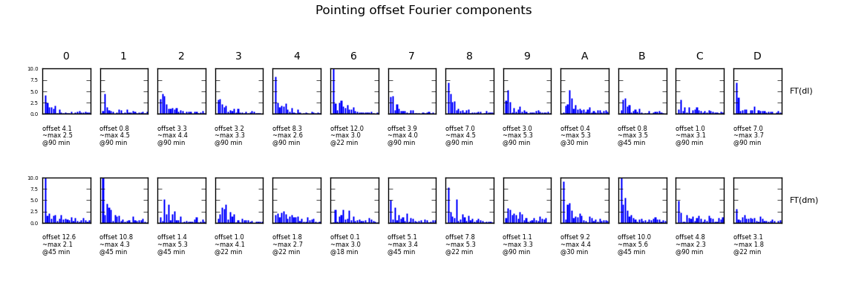
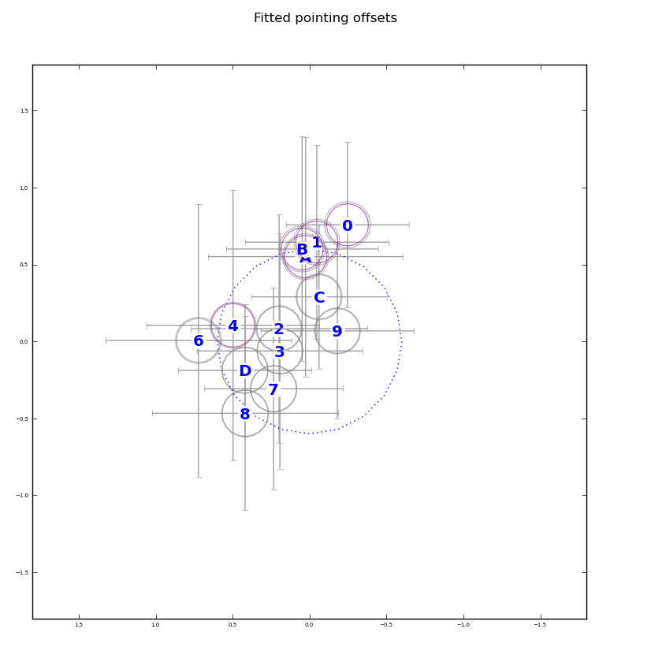
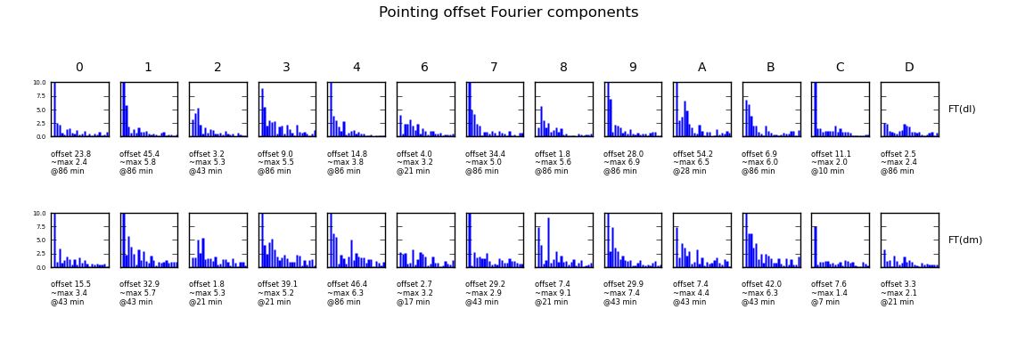
The Promise of a QMC
10 minutes of data is enough to characterize the static pointing quality (and 30-60-90 for dynamic).
Ian Heywood has already identified a QMC South!

Slide 67

Other Scary (Ghost) Stories

Slide 68

2004: The Ghosts of Cyg A
WSRT 92cm observation of J1819+3845 by Ger de Bruyn
String of ghosts from brightest source to CygA
(20° away!)
Perfectly circular
Present in all 8 bands
Position and size distribution does not depend on frequency
Wasn't clear if they were “in the data”, or a calibration artifact

Slide 69

2008: LOFAR Ghosts

Slide 70

2010: QMC2
(The Field That Keeps On Giving)
WSRT 21cm observation
String of ghosts connecting dominant sources A (220 mJy) and B (160 mJy)
Second, fainter, string from source A towards NNE (Do not cross the streams!)
Qualitatively similar to
2004 ghosts

Slide 71
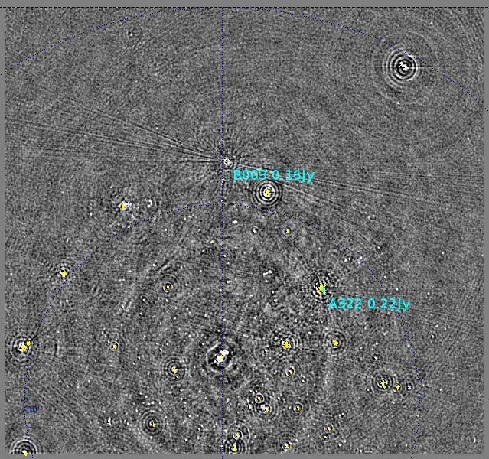
2010: QMC2
Busted!
...and then I busted them.
“Maybe now you'll never slime a guy with a positron collider!”
– Dr. Peter Venkman

Slide 72
To Bust Something Is To Understand It?
QMC2 calibration steps:
  Selfcal
  Differential gain solutions for A, B, and 6 other sources
  Repeat selfcal ← ghosts disappear
Repeated selfcal for J1819+3845 observation, with a frequency-dependent differential gain on Cyg A: ghosts busted
Independently, Ger de Bruyn repeated selfcal using an improved Cyg A model: ghosts busted

Slide 73
Poll: Who Understands Selfcal?
“If you are not completely confused by quantum mechanics, you do not understand it.”
– <John Wheeler|Niels Bohr>
“It is safe to say that nobody understands quantum mechanics”
– Richard Feynman
Second Law Of Smirnov:
You do not understand selfcal.

Slide 74
Ghostbusters: The Movie

Slide 75
Ghosts = Selfcal Contamination
MS1: Simulated 1 Jy source at phase centre
MS2: added three 1 mJy sources at various distances from centre (from 10' to 20°)
Did selfcal on MS2 using a sky model composed of only the 1 Jy source
  Selfcal solutions are thus slightly “contaminated” by the three off-axis sources
Applied these solutions to MS1, and subtracted central source
Result is “distilled artifacts”: flux from the central source that has been scattered by applying contaminated selfcal solutions

Slide 76
Ghastly Properties
On a line from contaminator to dominator
  ...and extend beyond both
Perfect circles
Sit at (some) natural harmonics
  1/2, 1/5, 4/5, 3/7, 4/7
  ...but not e.g. 2/5 or 2/7!!
Decrease in intensity with more baselines and more channels (for WSRT)
Full of surprises...

Slide 77
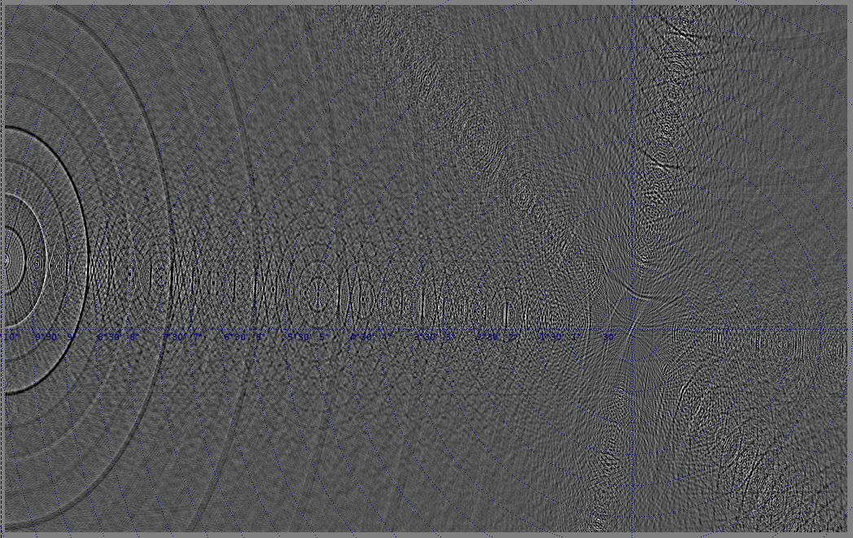
Ghastly Surprises
Going from 91 baselines (down with redundancy)...

Slide 78
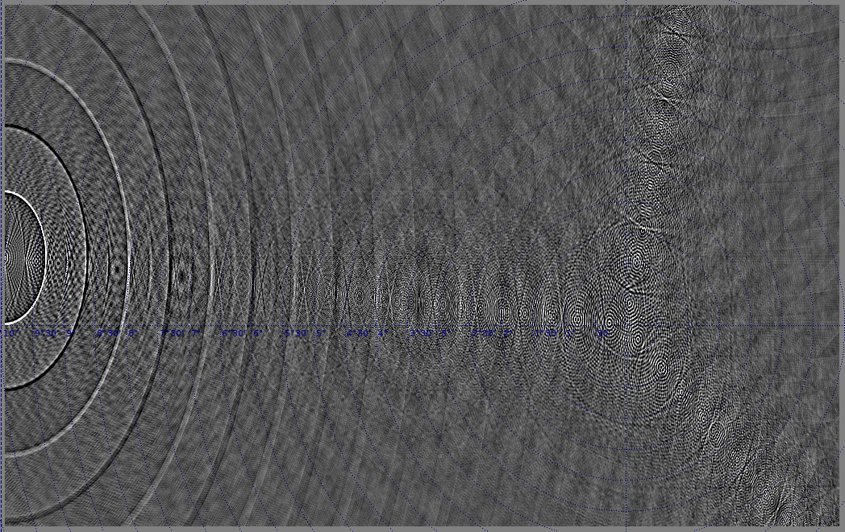
Ghastly Surprises
...to 40 baselines

Slide 79
Pop Quiz 1
What changes if we make the dominant source twice as bright?
  2 Jy dominator, 1 mJy contaminators

Slide 80
Ghastly Properties 2
Answer: NOTHING
Ghosts are proportional to contaminator flux, independent of dominator flux
Quite faint: <μJy for a mJy contaminator
  explains why we haven't been seeing more of them
  a luxury problem, formerly
  the 2004 case: a lot of Cyg A flux went unmodelled, due to frequency-dependent primary beam

Slide 81
Ghastly Mysteries
Why are they on a line?
Why the natural harmonics?
  Error modes correspond to ratios phase gradients?
Why the perfect circles?
  source needs to be sufficiently far for perfect circles to form up
Don't fully understand them, but we can simulate them into submission...

Slide 82
Pop Quiz 2
Ghosts don't change if we increase the dominator flux
...but what happens if we put that extra flux somewhere else, i.e. add a weaker source off-center?
  2 Jy source at center
  1 Jy off-center

Slide 83
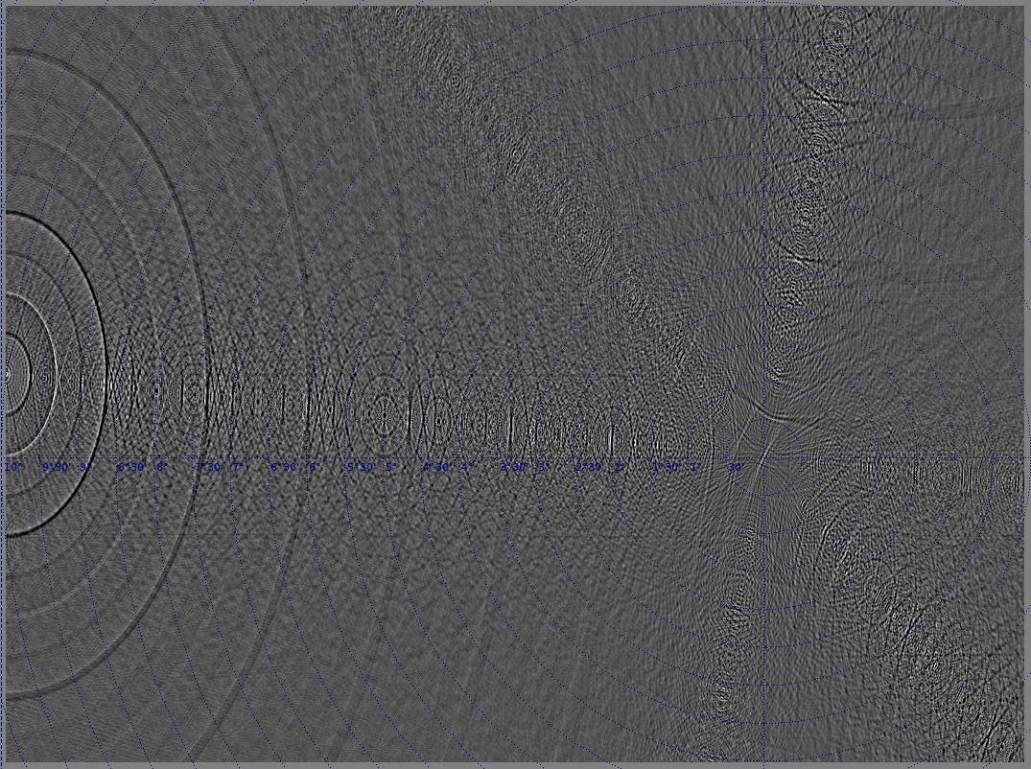
2 Jy central source – what if we add a second, 1Jy, source?

Slide 84
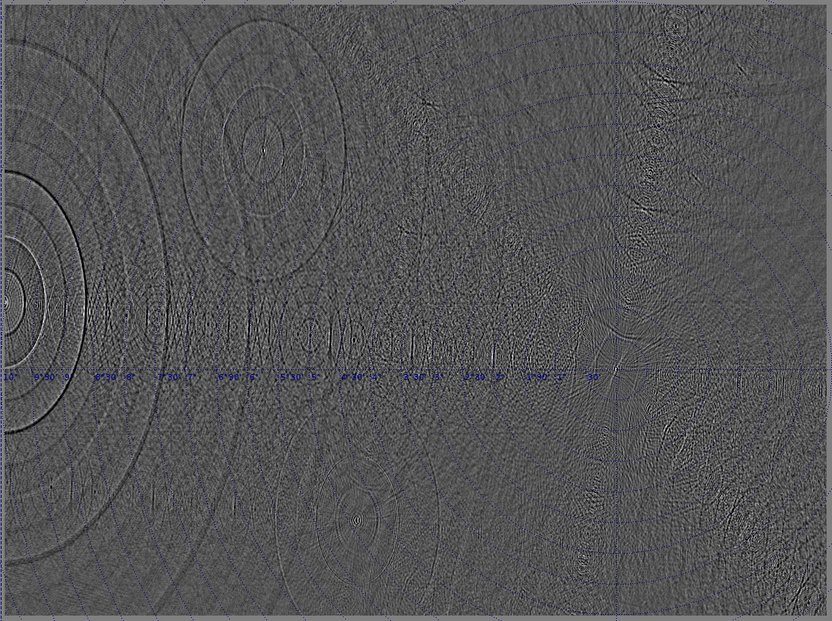
2 Jy central source, 1 Jy SE – now what if we flip them?

Slide 85
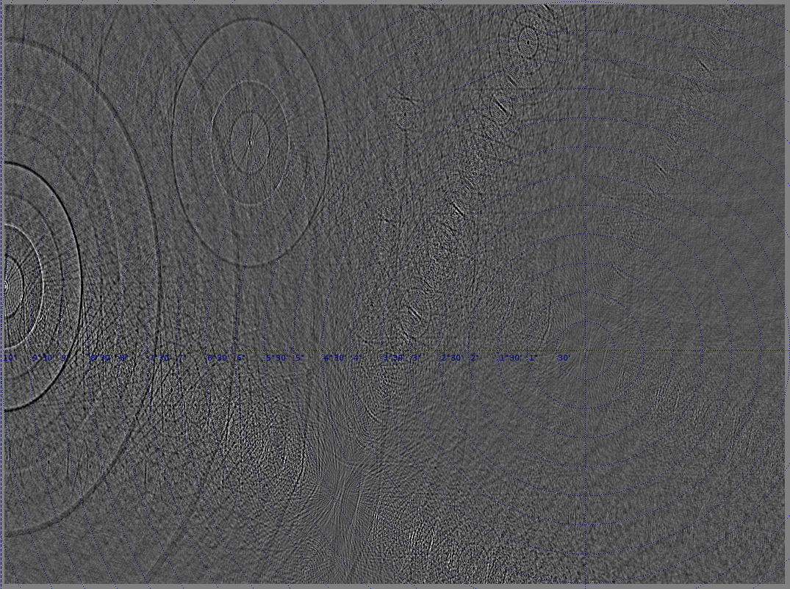
1 Jy central source, 2 Jy SE – now what if we make them equal?

Slide 86
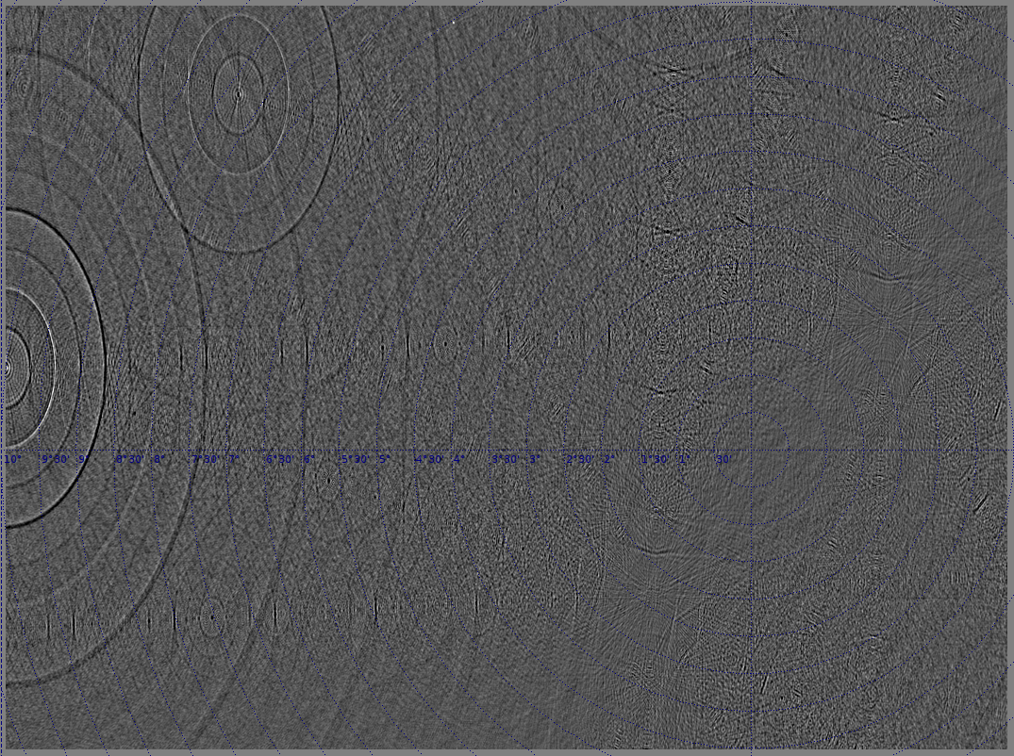
1 Jy source SE, 1 Jy NW

Slide 87
Array Configuration?
Conjectures: ghosts related to redundancy and/or periodicity and/or E-W config
Tested other telescopes (thanks to Ian Heywood for the layouts):
HEWT (Heywood East-West Telescope):
a log-WSRT
VLA Oranje: VLA-C, teleported to Holland
Vanilla VLAAA: a VLA-like log-spiral of 24 antennas

Slide 88

WSRT = 240 nJy

Slide 89
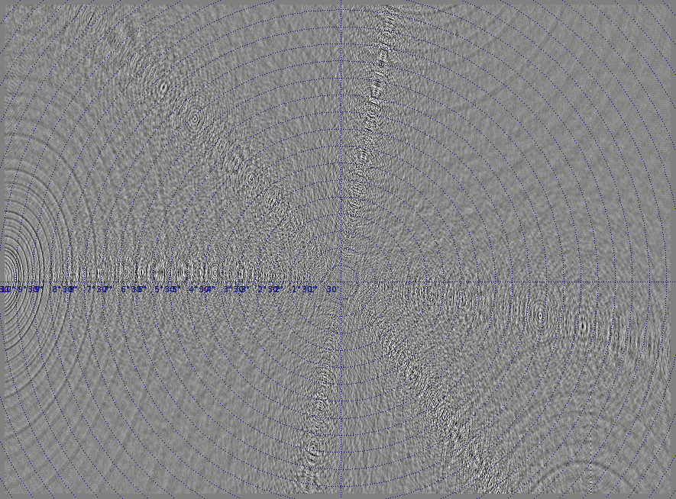
HEWT = 250 nJy

Slide 90

VLA = 93 nJy

Slide 91
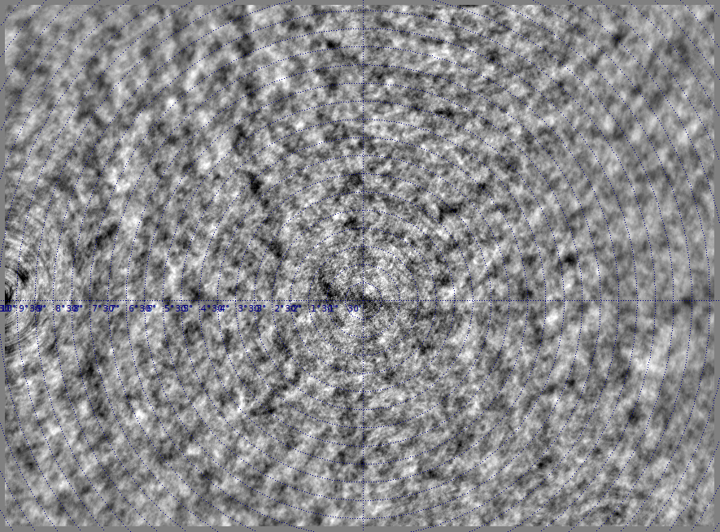
VLAAA = 330 nJy (worse than WSRT?!)

Slide 92
Implications & Burning Issues
We will always have contamination, so:
Possibility of coherent structures
  can they bias blind surveys?
Contamination adds to image noise
  Is this a dynamic range limitation?
“Strange” noise statistics
  How does this affect our ability to e.g. detect the EOR?
Non-trivial dependence on array config
  Both in terms of overall level, and distribution
  Does this follow from an existing Figure Of Merit?

Slide 93
Why Do We Trust Selfcal?
Peer pressure
Brainwashed as a PhD student
Stockholm syndrome
But mostly, because it
  Makes better maps
  And the gain/phase solutions make physical sense
We use priors to discriminate false results
  So can we feed our priors into calibration?
  Can we even trust our priors?

Slide 94
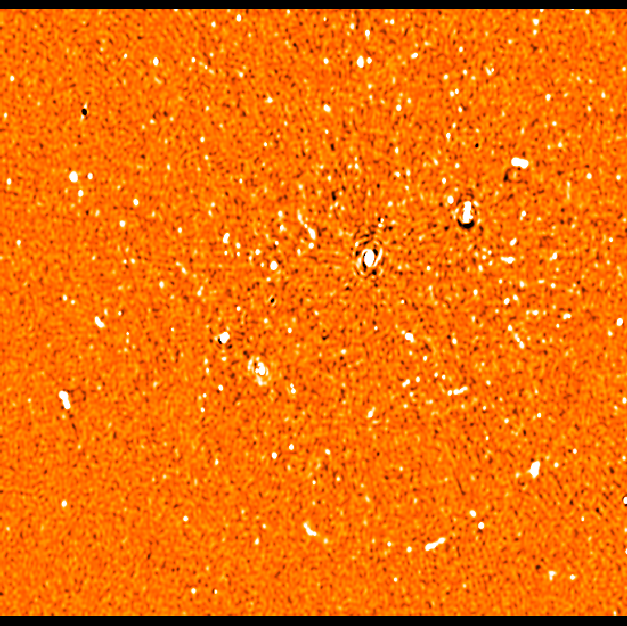
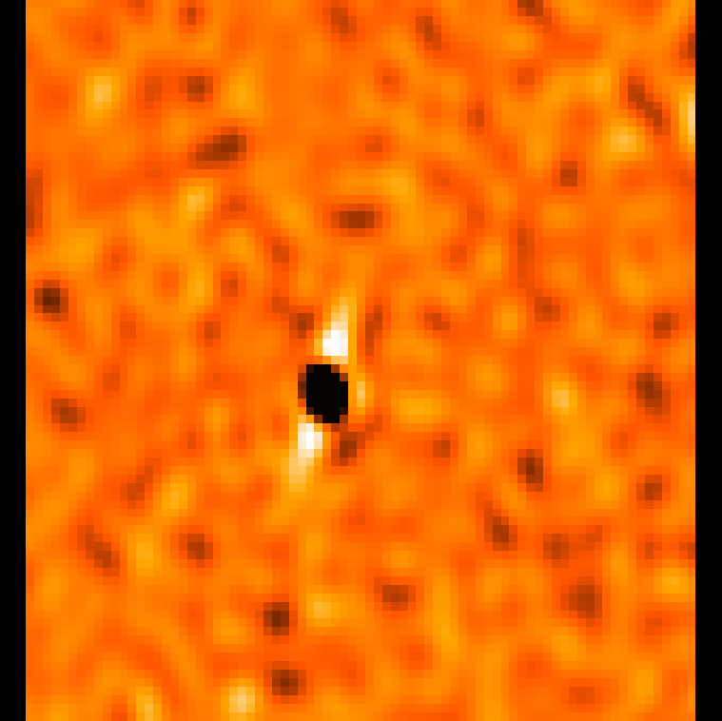
A Different Kind Of Ghost
A residual image from one of my HDR 3C147 experiments
Note artists' impression of an AGN...

Slide 95
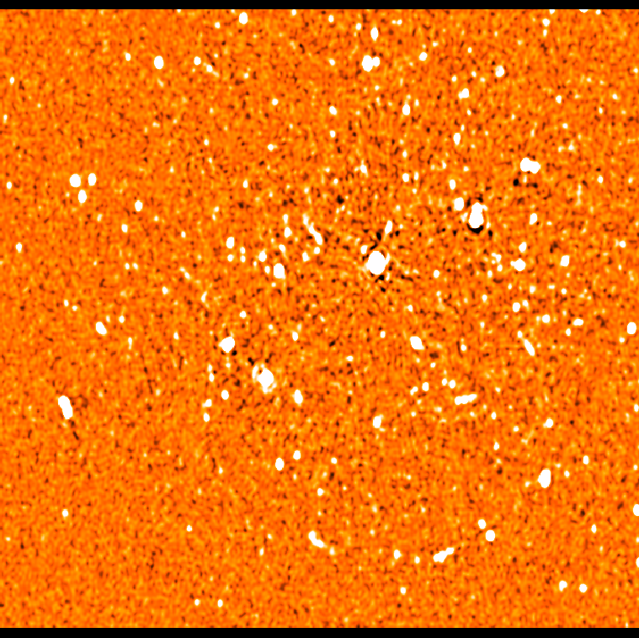
A Good Image, For Comparison
Spot the differences
Bright off-axis sources have negative counterparts symmetric w.r.t. dominant source (≠ phase centre!!!)
Can you guess what caused it?

Slide 96
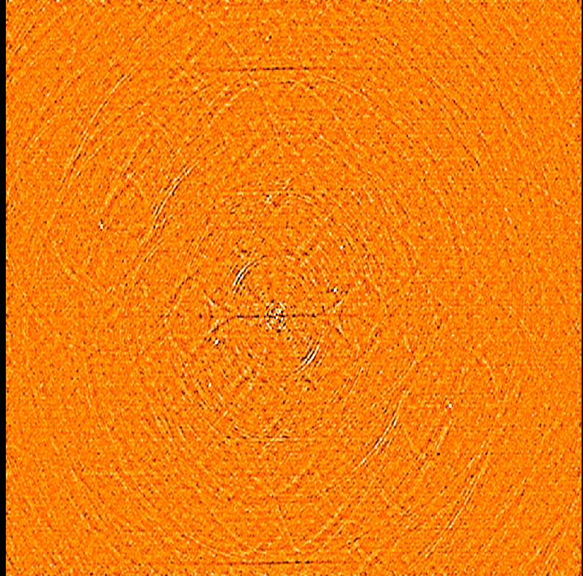
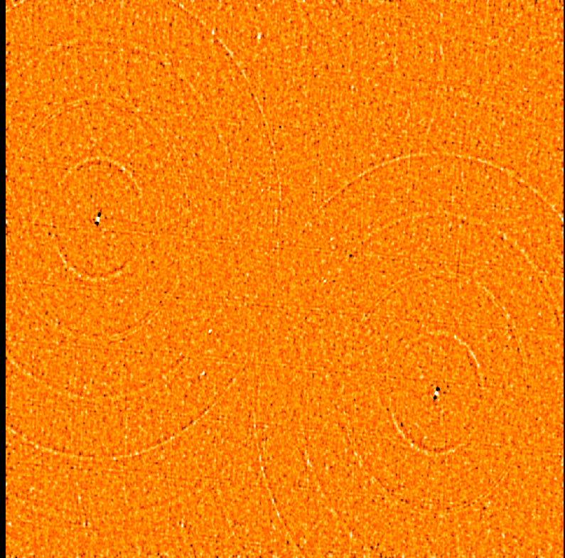
“Flagging Bias”
Amplitude-based flagging in the presence of significant flux can introduce coherent structure into the maps
Difference between flagged and unflagged:
uvbin method
timemed method

Slide 97
Conclusions
High dynamic range is hard
But this is precisely why we need to keep pushing for it
  Teaches us to solve tricky calibration problems
  Future surveys will need it
  SKA will need it on a routine basis
We need to go from one-off “heroic” results to routine “recipe” reductions
  ...still a long way, but at least there's no shortage of ideas

